Slide 1
Node Clustering

Slide 2
Motivation
Why clustering?
Principle
Clustering meta-algorithm
Classification of algorithms
What, when, how good
 Open issues
Challenges

Slide 3
Cluster Structure
Cluster head (CH)
Represents the cluster
Cluster administration (creation, maintenance, application distribution)
Coordination with other CHs (network topology)
Communication gateway and forwarding (not always)
Data processing (aggregation)
Battery draining
Members (Me)
Sensing environment
Cooperating with CH
Communication gateway (in some cases)
Minimal data processing
Battery saving
Gateways
Connected to more than one cluster head

Slide 4
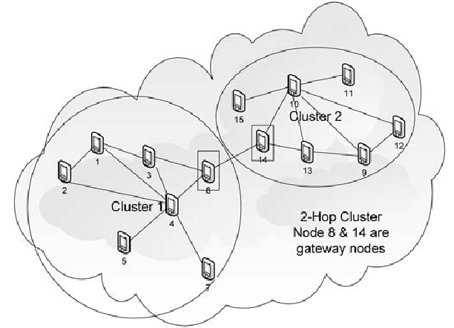

Slide 5
Node Clustering Structure
Applied to sensor networks with hierarchical structures to enhance the network performance while reducing the necessary energy consumption
To group nodes around a cluster head that is responsible for state maintenance and inter-cluster connectivity.
Cellular networks:
ﬁxed base stations are connected through wired backbones.
Single hop networks
To select and allocate channel groups to all the base stations within a system and to achieve efﬁcient frequency reuse
In multi hop wireless networks
To aggregates nodes into groups (clusters) to reduce the routing overhead and to provide a convenient framework for efﬁcient resource (e.g., bandwidth or code) allocation, energy management, fault –tolerant routing, and high end - to - end throughput.

Slide 6
In clusters without any cluster head, a proactive strategy is used for intra-cluster routing while a reactive strategy is used for inter-cluster routing. → Results in high traffic overhead
One node is selected as the cluster head of a cluster, and it acts as the local coordinator of transmissions within its cluster.
A cluster head performs additional functions as a central administration point
Drawback: Single Pointer of failure
The objective of the node clustering procedure is to find a feasible interconnected set of clusters that covers the entire node population.
For the initial deployment of the network, the nodes could be deployed in the coverage area
Regularly Placed Node Deployment
Randomly Distributed Node Deployment

Slide 7
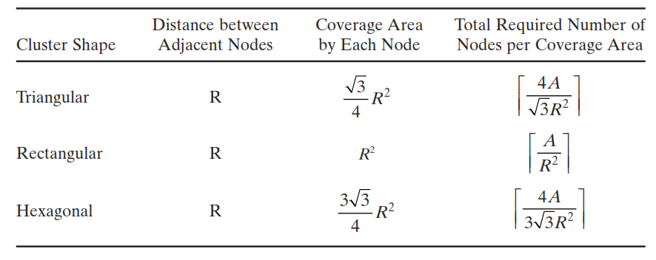
Regularly Placed Node Deployment

Slide 8
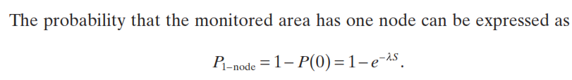

Randomly Distributed Node Deployment
Probability of at least k nodes placed in a area S

Slide 9
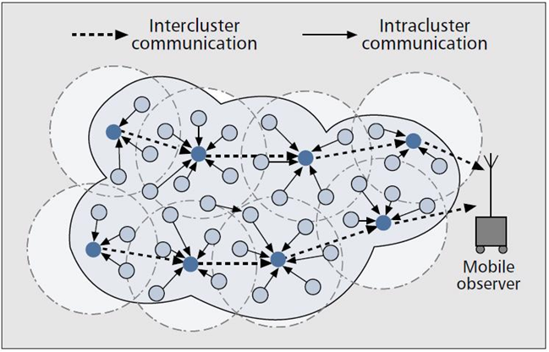
Data Flow

Slide 10
Clustering Meta Algorithm

Selecting/Electing CH
Construction phase
 Recruitment of Me
Intra-cluster resource
management
 Maintenance phase
Adaptation to external perturbations
Disruption / Rotation


Slide 11
Challenges
How to divide network into set of disjunctive clusters
Node cannot be member of two clusters
CH communicates with base station directly or via other CH
Collection of CH in the network form connected dominating set
Dominating set D of G=(V,E)
D ⊆ V :
Classical NP-complete decision problem
There is no efficient (*) algorithm to find smallest D

Slide 12
Why existing clustering algorithms fail in WSN
Different assumptions and design constraints
Unique deployment and operational characteristics
Deployed in ad-hoc
Large number of nodes (10s, 100s, 1000s), i.e. distributed over centralized approaches
Nodes are unaware of locations, i.e. algorithms must use only neighboring information
Due to energy constraints minimal message overhead is allowed
Due to harsh environment periodic reclustering, partial network infrastructure degradation
Parameters for clustering are not constants and evolve over time

Slide 13
Cluster head election algorithms
Lowest Id clustering
2 hop clustering
Nodes broadcast their IDs
The node with highest ID in its neighborhood declares itself as CH
Others will become ordinary members
Nodes that can hear from more than one CH acts as gateways
Advantage
Stable clustering in highly dynamic topology change networks

Slide 14
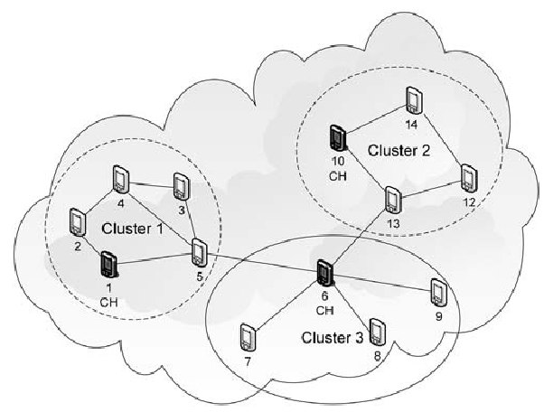
Lowest ID Clustering

Slide 15
Highest Connectivity Clustering Algorithm
Nodes broadcast their degrees within 1-hop neighbors
Nodes with highest degree become CH
In case of tie, Lowest ID having highest degree will become CH
Disadvantage
Incurs high message overhead
Cluster head changes frequently
Advantage
Due frequent CH changes, fair load distribution

Slide 16
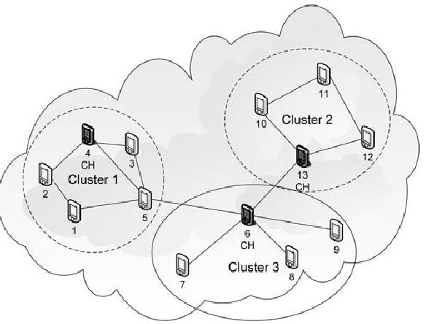
Highest Connectivity Clustering Algorithm

Slide 17
Least Cluster Head Change Algorithm
To support cluster stability
For initial clustering / re-clustering
Uses LID or HCN
No change when node joins or leaves a cluster
CH may change
If two CH come within transmission range of each other
If a node looses its membership from its cluster and forms a new cluster
Advantage
More robust in dynamic topology change networks
Low routing overhead and latency
Disadvantage
Unfair load sharing

Slide 18
Weighted Clustering Algorithm
Based on combined weight metric
Degree, distance, time spent as CH, speed
Highest weight node selected as CH
In case of tie LID is used
Disadvantage
Node has to wait for responses from neighbors → Latency increases
Higher message overhead

Slide 19
Specialties of WSN
Differences between WSNs and traditional ad hoc networks:
The number of sensor nodes in a WSN can be several orders of magnitude higher than that in an ad hoc network.
Sensor nodes are densely deployed.
Sensor nodes are prone to failures.
The topology of a WSN may change rather frequently because a sensor node may alternate between the active and sleep states.
Sensor nodes mainly use broadcast communications, whereas most ad hoc networks are based on point - to - point communications.
Sensor nodes are limited in power, computational capacities, and memory.
Sensor nodes may not have global identiﬁcation (ID) because of the large amount of overhead and the large number of sensors.

Slide 20
Passive Clustering for Efficient Flooding
Efﬁcient ﬂooding focuses on developing efﬁcient heuristics that select a suboptimal dominant set so as to lower forwarding overhead
Approaches for Selecting Dominant Set
Non-Clustering Approach
builds a source tree with maximum leafs
Flood packets are forwarded only by internal nodes. Leaf nodes do not forward flood packets
Clustering Approach
based on 2-hop clustering structure
Requires only direct neighbor information
No two CH are directly connected
The communication between CHs are only through gateways
Cluster head and gateways forward flood packets. Cluster members are only ordinary nodes.

Slide 21
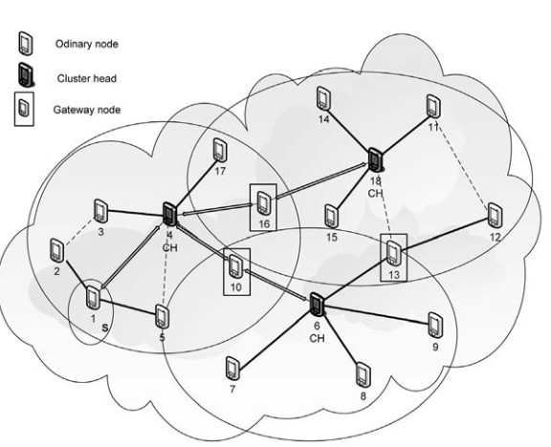

Slide 22
Merits and Demerits of Clustering Approach
Merits:
Reduces the ﬂood packets
Since the node clustering approach is based on the transmission range of the cluster heads, even if there are more sensor nodes in the network, the clustering structure and the broadcast will remain the same.
Demerits:
Clustering mechanisms rely on periodic broadcast of the neighbor list to ensure the correct collection of neighborhood information.
Use explicit control packets to elect a small set of nodes (cluster heads, gateway nodes, or ﬂood - forwarding nodes), and restrict the ﬂood forwarding function to such a set only.
These proactive mechanisms will incur trafﬁc overhead in the network.

Slide 23
Passive On Demand Node Clustering Algorithm
Dynamically partitions the network into clusters interconnected by gateway nodes.
Does not require periodic control messages to collect topological information.
Each node collects neighbor information from the MAC sender address carried by the incoming packets, and can construct clusters even without collecting the complete neighbor list.
Clustering status information (2 bits for 4 states:
INITIAL, CLUSTERHEAD, GATEWAY, and ORDINARY_NODE)
Cluster Status is piggybacked in a reserved ﬁeld in the MAC packet header.
All nodes maintain a cluster head list and a neighbor list with the sender ’s information on ID and reception time.
Whenever sending or receiving MAC packets, a node examines and updates its cluster-head and neighbor lists based on following rules.

Slide 24
Rule 1: Every sensor node is in the INITIAL state until it receives a MAC packet. If the sender ’ s state is not CLUSTERHEAD, this sensor node can change its own status into CLUSTERHEAD. This sensor node will become a cluster head if it successfully transmits an outgoing packet before it receives any packets from another cluster head. If the sensor node receives a packet from another cluster head before it becomes a cluster head, it adds the sender to its cluster head list, and changes itself to the ORDINARY_NODE state.
Rule 2: Any sensor node that hears from more than one cluster head becomes a GATEWAY. If it does not hear from more than one cluster head for a given period, its status is changed to the ORDINARY_NODE state.
Rule 3: If a sensor node receives packets from a cluster head, it updates or refreshes its cluster - head list.
Rule 4: If a cluster head node receives a packet from another cluster head, it goes into the ORDINARY_NODE state.
Rule 5: Every node collects the neighbor information as the clustering procedure proceeds. It stores its neighbors ’ ID, state, and idle time. If the idle time goes beyond the timeout threshold, the entry is removed. If the number of the cluster - head list becomes zero, the node will go to the INITIAL state.

Slide 25
Disadvantage → May result in large number of gateway nodes and cause signiﬁcant redundant ﬂood packets.
To select a minimal set of gateways
cluster - head list for each gateway node is collected, and then one gateway node is chosen for each pair of cluster heads
Introduces extra communication and computation overhead because the cluster head lists have to be exchanged among gateway nodes.
Heuristic gateway node selection algorithm
The nodes with more than two entries in their cluster head list is a candidate for a gateway node.
Upon sending a packet, this gateway node candidate selects two cluster heads from the cluster heads list and announces itself as the gateway node between the selected two cluster heads.
If a gateway node receives a packet from another gateway node that announced the same pair of cluster heads, this gateway node will compare its node ID with the sender ’s ID.
If this node has a lower ID than the sender’s, this node remains its role as the gateway node for that pair of cluster heads. Otherwise, this node can announce itself to be a gateway node for a new pair of cluster heads that has not been announced by other gateway nodes or this node changes its status from GATEWAY to ORDINARY_NODE state.
If an ordinary node has only one gateway node in its neighbor list and it belongs to only one cluster, it can be a distributed gateway node as long as there is no other gateway node in the same cluster

Slide 26
Merits of Passive Clustering
Does not need any periodic messages; instead, it exploits existing trafﬁc to piggyback its small control messages.
It is very resource efﬁcient regardless of the degree of neighbor nodes or the size of the network.
Provides scalability and practicality for choosing the minimum number of forwarding nodes in the presence of dynamic topology changes.
It can be easily applied to on - demand routing schemes to improve the performance and scalability.
Does not have any setup latency and it saves energy when there is no trafﬁc.
Clustering maintenance is well adaptive to dynamic topology and resource availability changes.

Slide 27
Example of Clustehead & Gateway Forwarding
1
3
4
5
6
7
8

Slide 28
Passive Clustering: example
Assume Node 1 initiates a search flood….
1
3
4
9
6
7
8
2
Notes:
This is an example of 2-hop clustering.
Blue nodes are cluster heads and yellow nodes are gateways and the rest of them are mobile stations which represent ordinary nodes

Slide 29
Passive Clustering

1
3
4
9
6
7
8
2
Notes:
This is an example of 2-hop clustering.
Blue nodes are cluster heads and yellow nodes are gateways and the rest of them are mobile stations which represent ordinary nodes

Slide 30
Passive Clustering
Clusterhead_ready

1
3
4
9
6
7
8
2
Notes:
This is an example of 2-hop clustering.
Blue nodes are cluster heads and yellow nodes are gateways and the rest of them are mobile stations which represent ordinary nodes

Slide 31
Passive Clustering
Clusterhead

1

3
4
9
6
7
8
2
Notes:
This is an example of 2-hop clustering.
Blue nodes are cluster heads and yellow nodes are gateways and the rest of them are mobile stations which represent ordinary nodes

Slide 32
Passive Clustering
Ordinary Node

1

3
4
9
6
7
8
2
Notes:
This is an example of 2-hop clustering.
Blue nodes are cluster heads and yellow nodes are gateways and the rest of them are mobile stations which represent ordinary nodes

Slide 33
Passive Clustering

1


3
4
9
6
7
8

2
Notes:
This is an example of 2-hop clustering.
Blue nodes are cluster heads and yellow nodes are gateways and the rest of them are mobile stations which represent ordinary nodes

Slide 34
Passive Clustering

1


3
4
9
6
7
8

2
Notes:
This is an example of 2-hop clustering.
Blue nodes are cluster heads and yellow nodes are gateways and the rest of them are mobile stations which represent ordinary nodes

Slide 35
Passive Clustering

1


3

9
6
7
8

4
2
Notes:
This is an example of 2-hop clustering.
Blue nodes are cluster heads and yellow nodes are gateways and the rest of them are mobile stations which represent ordinary nodes

Slide 36
Passive Clustering

1


3

9
6
7
8

4
Notes:
This is an example of 2-hop clustering.
Blue nodes are cluster heads and yellow nodes are gateways and the rest of them are mobile stations which represent ordinary nodes

Slide 37
Passive Clustering

1


3

9
6
7
8

4

2
Notes:
This is an example of 2-hop clustering.
Blue nodes are cluster heads and yellow nodes are gateways and the rest of them are mobile stations which represent ordinary nodes

Slide 38
Passive Clustering
Gateway

1


3

9
6
7
8

4

2
Notes:
This is an example of 2-hop clustering.
Blue nodes are cluster heads and yellow nodes are gateways and the rest of them are mobile stations which represent ordinary nodes

Slide 39
Passive Clustering

1


3


9
6
7
8

4

2
Notes:
This is an example of 2-hop clustering.
Blue nodes are cluster heads and yellow nodes are gateways and the rest of them are mobile stations which represent ordinary nodes

Slide 40
Passive Clustering

1


3


9
6
7
8

4

2
Notes:
This is an example of 2-hop clustering.
Blue nodes are cluster heads and yellow nodes are gateways and the rest of them are mobile stations which represent ordinary nodes

Slide 41
Passive Clustering

1



3


9
6
7
8

4

2
Notes:
This is an example of 2-hop clustering.
Blue nodes are cluster heads and yellow nodes are gateways and the rest of them are mobile stations which represent ordinary nodes

Slide 42
Passive Clustering

1



3


9
6
7
8

4


2
Notes:
This is an example of 2-hop clustering.
Blue nodes are cluster heads and yellow nodes are gateways and the rest of them are mobile stations which represent ordinary nodes

Slide 43
Passive Clustering

1





7
8
3

9
6

4


2
Notes:
This is an example of 2-hop clustering.
Blue nodes are cluster heads and yellow nodes are gateways and the rest of them are mobile stations which represent ordinary nodes

Slide 44
Passive Clustering

1





7
8
3

9
6

4


2
Notes:
This is an example of 2-hop clustering.
Blue nodes are cluster heads and yellow nodes are gateways and the rest of them are mobile stations which represent ordinary nodes

Slide 45
Passive Clustering

1






7
8
3

9
6

4


2
Notes:
This is an example of 2-hop clustering.
Blue nodes are cluster heads and yellow nodes are gateways and the rest of them are mobile stations which represent ordinary nodes

Slide 46
Passive Clustering

1






7
8
3

9
6

4


2
Notes:
This is an example of 2-hop clustering.
Blue nodes are cluster heads and yellow nodes are gateways and the rest of them are mobile stations which represent ordinary nodes

Slide 47
Passive Clustering

1







7
8
3

9
6

4


2
Notes:
This is an example of 2-hop clustering.
Blue nodes are cluster heads and yellow nodes are gateways and the rest of them are mobile stations which represent ordinary nodes

Slide 48
Passive Clustering

1






8
3


9
6
7


4


2
Notes:
This is an example of 2-hop clustering.
Blue nodes are cluster heads and yellow nodes are gateways and the rest of them are mobile stations which represent ordinary nodes

Slide 49
Passive Clustering
Resulting cluster structure.

1






8
3


9
6
7


4


2
Notes:
This is an example of 2-hop clustering.
Blue nodes are cluster heads and yellow nodes are gateways and the rest of them are mobile stations which represent ordinary nodes

Slide 50
Summary
Flooding
Broadcast to the whole network or part of it
Widely used in Ad hoc networks
Inefficient when the ad hoc network is very dense
Efficient Flooding
Choose the set of dominant forwarding nodes that cover the entire network
Passive Flooding
Use Passive Clustering to construct underlying cluster platform
Only Clusterheads and gateways forward packets
On-demand (zero overhead if no user data)

Slide 51
Conclusion
Passive clustering
Use non ordinary node to forward packet
Effective gateway selection heuristic
Gateway reduction mechanism
Control overhead free

Slide 52
Energy Efficient Clustering
Cluster heads are responsible
intra-cluster coordination
inter-cluster communication
Cluster head may consume energy at a much faster rate.
Dynamically changing cluster head algorithm to distribute energy consumption as evenly as possible
Assumptions
The base station is located far from the sensor nodes and is stationary.
All sensor nodes in the network are homogeneous and energy constrained.
All sensor nodes are able to reach the base station.
Sensor nodes have no location information.
The propagation channel is symmetric.
Cluster heads perform data compression.

Slide 53
Life time of sensor node
First Node Dies (FND)
Half of the Nodes Alive (HNA)
Last Node Dies (LND)
LEACH
Low Energy Adaptive Clustering Hierarchy
Forms clusters based on the received signal strength
Uses local cluster heads as routers to the base station
All sensor nodes within a cluster turns → balanced energy consumption at all nodes → increases network lifetime.
Desired percentage of cluster heads in the network (P)
Operates in rounds
Each round has two phases : Set up phase and steady state phase

Slide 54
LEACH
Aims to minimize energy consumption through a cluster-based operation.
Goal - To dynamically select sensor nodes as cluster heads and form clusters in the network. The communications inside the clusters are directed to the cluster head, which performs aggregation.
Cluster heads directly communicate with the sink to relay the collected information from each cluster.
Changes the cluster head role dynamically such that the high-energy consumption in communicating with the sink is spread to all sensor nodes in the network.
The operation of LEACH is controlled through rounds, which consist of several phases.
During each round, each cluster formation stays the same, and the cluster heads are selected at the beginning of each round.
A round is separated into two phases, the setup phase and steady state phase.

Slide 55
Setup phase – Cluster heads Selection and cluster formation, Cluster Communication Schedule Determination.
Steady state phase - Data communication between cluster members and the cluster head
To minimize overhead → Duration of the steady state phase is longer than the duration of the setup phase
Setup phase consists of three phases: advertisement, cluster setup, and schedule creation.
Randomly selects sensors as cluster heads during the beginning of each round.
Cluster head selection is performed through the advertisement phase → Sensor nodes broadcast a cluster head advertisement message.

Slide 56

Sensor node chooses a random number (rno) between 0 and 1.
If rno < T(n) (threshold), sensor node becomes a cluster head.
P - Desired % to become a cluster head,
r – Round No.,
G - Set of nodes that have not been selected as a cluster head in the last 1/P rounds
Selected cluster heads advertise to their neighbors in the network that they are the new cluster heads. (Uses CSMA)
Sensor nodes upon receiving the advertisement, determine the cluster that they belong to.
Receives from a single cluster head →Becomes a member of that cluster.
Receives from multiple cluster heads → Chooses the cluster head with the highest signal strength

Slide 57
In cluster setup phase, the sensor nodes inform the associate cluster head that they will be members of the cluster
In schedule creation phase the cluster heads assign the time during which the sensor nodes can send data to the cluster heads based on a time division multiple access (TDMA) approach
Then it goes into steady state phase in which the sensor nodes can begin sensing and transmitting data to the cluster heads.
The cluster heads aggregate data from the nodes in their cluster before sending these data to the sink.
At the end of the steady state phase, the network goes into the setup phase again to enter into another round of selecting the cluster heads.
Energy consumption due to the cluster head duty is equally distributed among sensor nodes.

Slide 58
Advantages and Disadvantages
Provides optimized behavior
self-organized
Mobility is supported; New nodes have be synchronized to the current rounds; Node failures leads to new CH election
Stochastic CH selection may lead to higher energy consumption since after two or more rounds, selection of favorable CHs at the current round can result in an unfavorable CH selection in the later rounds
A deterministic CH selection algorithm can overcome the above disadvantage
Reducing T(n) relative to node’s remaining energy increases the lifetime of network

Slide 59
Hybrid Energy Efficient Distributed Clustering (HEED)
Goals
Prolonging network lifetime by distributing energy consumption
Terminating the clustering process within constant no. of iterations
Minimizing the control overhead
Producing well-distributed cluster heads and compact clusters
Based on
residual energy – Used to probabilistically select an initial set of CHs
intra-cluster communication cost as a function of neighbor proximity and cluster density – Used to break the ties

Slide 60

HEED
Performed in rounds
C_{prob} – Initial % of CHs in the network (predefined) – Used to limit the initial CH announcements
CH_{prob} – Probability of becoming cluster head
E_{residual} – Estimated current residual energy
E_{max} – Maximum energy
CH_{prob}>p_{min}
If CH _{prob} <1 – Tentative CH
CH_{prob} = 1 – Final CH

Slide 61
CH election in HEED
Every sensor node that never heard from a CH elects itself to become CH with probability CH_{prob}.
Broadcasts tentative-CH or final CH msg.
Sensor nodes hearing the CH list selects the CH with the lowest cost from the set of CHs
Every node doubles its CH_{prob} and goes to next step.
If a node completes the HEED execution without electing it as a CH, or joining a cluster, it announces itself as a final CH.
A tentative CH become a regular node at a later iteration of it hears from a lower cost CH.

Slide 62
Advantages
Does not need to do neighbor discovery very often
Distribution of energy consumption extends network lifetime
Nodes automatically updates their neighbor sets in multi-hop networks by periodically sending and receiving messages.
HEED improves network lifetime over LEACH because LEACH randomly selects CHs which may result in faster death of some nodes
Final set of selected CHs are well distributed across the network and the communication cost is minimized

Slide 63
Energy Efficient Hierarchical Clustering
Multitier Hierarchical Clustering
Energy-Efficient Hierarchical Clustering(EEHC)
Distributed Weight-based Energy-efficient Hierarchical Clustering (DWEHC)

Slide 64
Any node can initiate cluster formation process, but not simultaneously
If multiple nodes starts the process simultaneously, only the node with lower ID is allowed to proceed.
Two phases: Tree discovery and cluster formation
Tree Discovery
To generate a BFS tree rooted at initial node r
Each node broadcasts its shortest hop distance from r
If any neighbor node v of u finds a route to r through u is shorter, chooses u as its parent.
Beacon message (source ID, parent ID, root ID, subtree size)
Every node updates its subtree size when its children subtree size changes
When the size of any subtree on a node exceeds the size k, moves to the cluster formation phase
Cluster Formation
The node for which the size of subtree exceeds k, initiates cluster formation
A single cluster for the entire subtree is created if the entire subtree size is <2k.
Otherwise Multiple clusters are formed.
Deletes BFS tree and keeps only cluster information
Suitable for handling dynamic environments

Slide 65
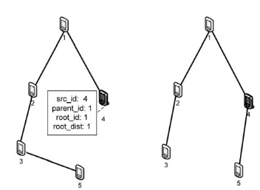
Change of part of the BFS tree

Slide 66
Multi Tier Hierarchical Clustering (MTHC)
Hierarchical clustering based on
Cluster Size
Degree of overlap
Goals
No isolated cluster in the network
All clusters should have minimum and maximum size constraints
A node in one layer of the hierarchy belongs to a constant number of clusters in that layer
The degree of overlap between any two clusters within one layer should be low.
Cluster information should be stable across node mobility

Slide 67
Energy Efficient Hierarchical Clustering (EEHC)
Distributed randomized clustering algorithm
Maximizes the network lifetime
Suitable for large network size
CH collects information from sensors within its cluster and send an aggregated report through the hierarchy of CHs to the base station
Assumes the communication medium is contention free and error free
Energy consumed in the n/w depends on
Probabilities of each sensor node becoming CH at each level in the hierarchy
The maximum no. of hops allowed between cluster node and its CH
Goal: Minimizing the total energy consumption in the n/w
Two-stage clustering process:
Single level clustering
Multi level clustering

Slide 68
Single level clustering Stage
Each sensor node becomes a CH at a predefined probability p and announces itself as a volunteer CH to its neighbor nodes that are within k-hops communication range
Any node that receives such an announcement becomes a member of the closest cluster if it is not a CH
Those that are neither CH or member, forced to become CHs
If no announcement received within time interval t, becomes forced CH
t- based on duration for a packet to reach a node k-hop away
Energy consumed by the network depends on p and k
To get optimal p and k, assumptions made are:
Distribution of nodes is based on homogenous spatial Poisson process of intensity λ in 2D space
All sensor nodes transmit at the same power level and have the same transmission range r.
Data exchanged between 2 sensor nodes beyond range r is forwarded by intermediate nodes
Transmission hops between any sensor and its CH is equivalent to ⎡d/r⎤ hops
Energy consumed to transmit or receive one unit of data is one unit at each node
When a sensor communicates data to another sensor only the sensors on the routing path forwards the data
There is no retransmission since medium is contention free and error free

Slide 69
Multi level clustering stage
Same mechanism extended from bottom up
Data forwarding from level 1 to level h aggregated at each level also
Cost of transmission = energy consumed by sensor nodes at that level for sending information + cost of forward the aggregated information to base station k-hops at level I
Problem:
CHs consume relatively more energy than other sensor nodes
CHs may run out of their energy faster than others
Solution:
EECH algorithm can be run periodically for load balancing or triggered as the energy levels of CHs fall below a certain threshold

Slide 70
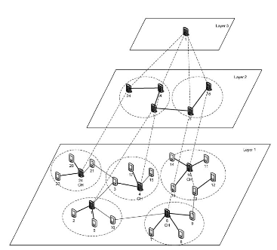
Three layer hierarchy

Slide 71
Distributed Weight-based Hierarchical Clustering (DWEHC)
To achieve balanced cluster size
To optimize intra-cluster topology
No assumption on the size and density of n/w
But sensors are aware of its location
All sensors transmit at the same fixed power level
Cluster radius:
The farthest transmission distance from one cluster member to its head
Fixed cluster radius for entire network
Generates a multi-hop intra-cluster structure
CH is at root
Members are in a breadth first order
Each cluster has multiple levels of child nodes
No. of levels within one cluster is determined by the cluster radius
The minimum energy path from one member to its CH is established by DWECH

Slide 72

Each node responds only to its nearest parent request
Parent respond’s to its own parent
Continues until the data reaches the CH
TDMA is used for intra-cluster communication
CHs uses IEEE 802.11 for channel access to base station
Each sensor first broadcasts its (x, y) to its neighbors
After locating all neighbors in its transmission range, each node calculates its weight as:
E_{residual} (S)– Residual energy of S; R-cluster range
E_{initial} (S)– Initial energy of S; d – distance(s,u)
α - transmit power factor (2 or 4); c -constant

Slide 73
A node that has largest weight among all its neighbors become temporary CH
A temporary CH becomes a real CH if a given % of neighbors elect it as their CH.
When i=0 this is set to 100% and in subsequent 6 iterations it is decreased by (6-i)/6
At this stage the neighboring nodes are considered as first-level child members w.r.t the CH
Node progressively adjusts such memberships in order to reach the CH using the least amount of energy.
A node checks with its non CH neighbors to find out its minimal cost to reach CH.
With the knowledge of the distance to its neighbors, a node assess whether it is better to stay as a first level member or become second-level member.
A node may also switch to a new CH if it seems better
The process continues until all nodes settle on the most energy-efficient intra cluster topology.
The cluster generating process runs at most 7 times.

Slide 74
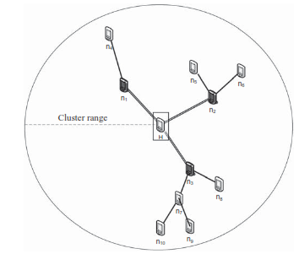

Slide 75
Advantages
Completely distributed
Each node is either a CH or a child member in a cluster
Each cluster contains the minimum-power topology which is locally optimal
Each parent has a limited no. of children and hence it is scalable
Achieves load balance per node and hence prolongs the lifetime of CH
No assumption on network size
Clusters generated by DWEHC are more load balanced than those by HEED
Achieves lower energy consumption in intra-cluster and inter-cluster communication.

Slide 76
Algorithm for Cluster Establishment
Employs an emergent localized cluster formation and uses only 3 rounds of feed back to induce the formation of a highly efficient cover of uniform clusters
Uses repeated local interaction and feed back between nodes to achieve the desired global property without a central control or global visibility
Phases:
Spawning new clusters
Migration of existing ones
Spawning new cluster
Each node assesses its potential as CH.
When a node decides to be a new CH broadcasts an invitation message
Upon getting an invitation message, a neighbor sensor node may join the new cluster
A node can receive more than one invitation, but it can join only one cluster
Migration of existing cluster
Controlled by CH
Each CH evaluates the ability of its neighbors for becoming a new CH
A node will be considered as the best candidate for the new CH if the newly formed cluster could have the largest no. of member nodes with minimal overlaps with existing clusters

Slide 77
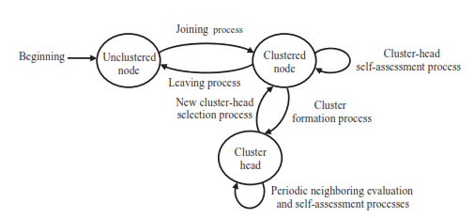
State Transition Diagram
States of a node: Unclustered, Clustered, CH

Slide 78
ACE
All nodes are initially unclustered
Need not work in synchronized rounds
Waits for random amount of time before making decision
Feedback occurs when a node A affect node B, which directly or indirectly affects node A again
No. of rounds decided by considering the trade-off between comm. Overhead and cluster size
Uses three rounds in the initial version
Modified version uses five rounds to increase the regularity of cluster layout

Slide 79
Advantages
Increases spatial coverage by increasing separation among clusters when node degree is high and allowing the clusters to be overlapped when degree is low.
Achieves low variance and high average of cluster size
Can easily repair structure damage in network caused by node failures and also can integrate new nodes
Fast, robust against packet loss and node failures, efficient in terms of communication
Completes in constant time regardless of the size of the network
Uses only local communication
Does not require geographic location information or distance, or direction between nodes

Slide 80
Secure Clustering
Common Key Distribution algs. Can’t be applied to WSN because
Processing requirement of public-key based distribution is high
Security vulnerabilities with global keying schemes
Memory requirements complete pairwise key distribution is high
Inefficiency and energy consumption of centre-based key distributions
In cluster-based network
CHs are more prominent targets for attacks.
A compromised CH may forward bogus information into the n/w.
LEACH provides security by rotating CH role

Slide 81
In LEACH: 2 kinds of authentication for legitimate nodes
Authenticated Broadcast (From CH to rest)
Pairwise Authentication (Noe-to-CH & CH-to-BS)
F-LEACH – security enhanced LEACH
Each node has two symmetric keys:
an authenticated broadcast key from a key chain held by the BS
A pairwise key shared with the BS
CH sends modified ADV having (ID in plaintext, A MAC produced using the key that the CH shares with the BS)
BS listens and authenticates ADV messages from all CHs and broadcasts the authenticated CH list using broadcast authentication scheme
The ordinary nodes selects its CH only from the authenticated CHs

Slide 82
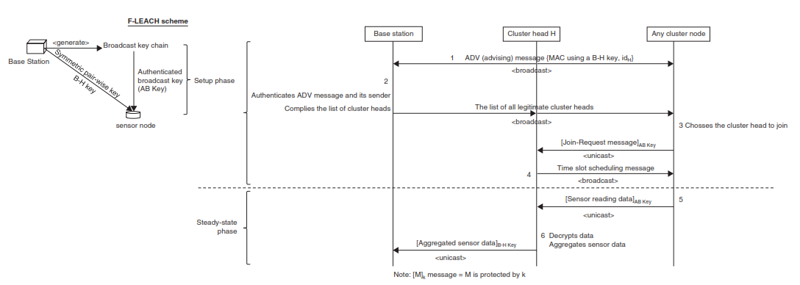

Slide 83
Disadvantages of F-LEACH
F-LEACH does not provide a complete and efficient solution to node-to-CH authentication
Join request messages in the setup phase are not authenticated and ordinary nodes only share keys with base station
CHs cannot verify the message authentication codes from ordinary nodes

Slide 84
SecLEACH
LEACH based random key distribution scheme that provides efficient security to pairwise node-to-CH communication
Each node is assigned a set of keys drawn from a large key pool.
Three phases:
Key pre-distribution – Takes place prior to network deployment. A large pool of S keys and their ids are generated. Each node is assigned a ring of m keys drawn from the pool at random without replacement
Shared-key discovery – Takes place during network setup. Each node broadcasts the IDs of the keys on its key ring. From this, a node finds out the keys shared with its neighbors. These keys are used for establishing secure links between two neighboring nodes
Path-key establishment – Each pair of neighboring nodes that do not share a key establish their own key as long as they are connected by two or more secure links at the end of the shared key discovery phase

Slide 85
Generates a large pool of S keys with their IDs prior to network deployment
Each node is assigned a ring of m keys drawn from the pool pseudo randomly without replacement
Each node X generates a unique ID id_{x} with one pseudo random function (PRF).
Id_{x} is used to seed a Pseudo Random Number Generator (PRNG) to produce a sequence of m numbers
The R_{x} parameter is the set of key IDs assigned to X and can be obtained by mapping each number in the sequence to its corresponding value mod s.
Each node is assigned with a pairwise key share with the base station prior to network deployment

Slide 86
When a self-elected CH broadcasts its ADV message, it includes the keys in its ring; the remaining nodes then cluster around the closest CH with whom they share a key
CH, H broadcasts its ID id_{H} and a nonce (to prevent replay attacks)
Ordinary nodes A_{i} compute the set of H’s key IDs using the above pseudorandom scheme, choose the closest CH with whom they share a key k_{[r]} , and send it a join-request message, protected by a message authentication code (MAC). The MAC is generated by using k_{[r]}, and includes the nonce from H’s broadcast in Step 1 as well as the ID_{r} of the key chosen to protect this link.
The cluster heads send the timeslot schedule to their member nodes that are chosen to join their clusters. This completes the setup phase.
In the steady - state phase, node-to-CH communications are protected by using the same key that was used to protect the join-request message in Step 2. A value nonce, computed from the nonce and the reporting cycle(j), is also included to prevent replay attacks.
CH can decrypt the data reports they received, perform data aggregation and send the aggregated result to BS. The aggregated result is protected with the symmetric key shared between the CH and BS. Also a counter c is shared between CH and BS and is included in the MAC to avoid replay attacks.

Slide 87
There will be multiple cycles in each round
For each cycle the counter value c is incremented by 1 and nonce is updated
SecLEACH runs in conjunction with the authenticated broadcast in F-LEACH
At the end of clustering process some nodes will not be clustered with a CH because of the key sharing constraints.
No. of unclustered nodes depends on the values of S and m
To achieve maximum security and energy efficiency S and m values and the no. of CHs should be optimized

